Slide 1



DSO-DERA Coordination for the Wholesale Market Participation of Distributed Energy Resources
FERC order 2222
Distributed energy resource aggregator (DERA)
Wholesale Market Participation of DERA: DSO-DERA Coordination and Competitive DER Aggregation
Presenter: Cong Chen
Authors: Cong Chen¹, Ahmed Alahmed¹, Subhonmesh Bose³,
Timothy Mount², and Lang Tong¹
¹Dept. of Electrical & Computer Engineering, Cornell University, Ithaca, NY, USA
¹Dyson School of Applied Economics and Management, Cornell University, Ithaca, NY, USA
²Dept. of Electrical & Computer Engineering, University of Illinois Urbana-Champaign, Urbana (UIUC), IL , USA
09/2023
Notes:
Hello everyone! My name is Cong Chen. Currently, I’m a Ph.D. candidate in Electrical Engineering from Cornell University supervised by Prof. Lang Tong. Today, I would like to share our research about the wholesale market participation of distributed energy resource aggregator (DERA).
Since 2020, FERC order 2222 began to promote the participation of DERA in the wholesale market. But why we emphasize the coordination problem here? Because most DERA do not own the network. And to participate in the wholesale market, DERA has to coordinate with DSO, the owner of the distribution network. How does multi-DERA share the distribution network? Who should be responsible for the network security? How to formulate a competitive aggregation method as customers can choose from multi-DERA to be aggregated? These are fundamental questions for the coordination of DSO-DERA.

Slide 2
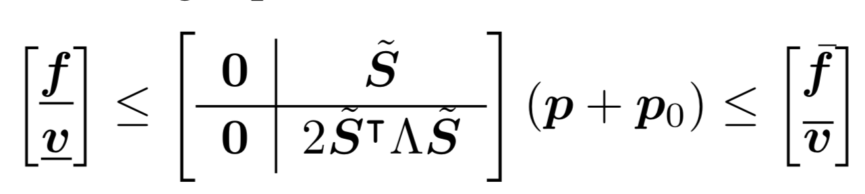
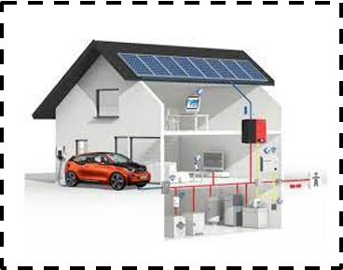
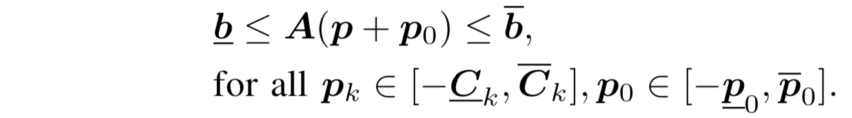
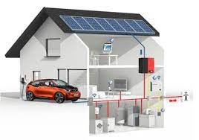
A Future Aggregation Model for multi-DERA
DSO-DERA-ISO coordination: How do multi-DERA share the power network? How to guarantee reliability?
DERA1
DSO
DERA2
Wholesale electricity market
(ISO)
Wholesale electricity market
(ISO)
DERA4
DERA3
POI
(b)
Transmission grid
Substation
A
(c)
Distribution grid
Line flow limits
Distribution utility and LSE
(DSO)
DER aggregator (DERA)
Distribution utility and LSE
(DSO)
DER aggregator (DERA)
PCC
Voltage limits
(a)
DERA customers
DSO customers
DERA customers
DSO customers
Retail customers in distribution systems
Retail customers in distribution systems
Control
Financial flow ($)
Control
DSO (net) power
Power flow (kW)
Financial flow ($)
Power flow (kW)
DERA1 (net) power
DERA2 (net) power
Competitive DER aggregation: (a) DERA aggregation model, (b) DERA’s bids in the wholesale market, and (c) DERA’s bids in distribution network access auction.
Network Access
Network Access
5kW
Day1
Day2
Day3
Day1
Day2
Day3
-5kW
Notes:
We know the structure of power system with ISO, DSO and all retail customers like this. And we envision future there’re multiple DERAs, each has its own customer. Customers have the freedom to choose their incumbent utility company or choose to be aggregated by some DERA. From here we can more clearly see that DSO is responsible to operate physical distribution network power flow represented by the red arrows and ensure the network security and reliability. To participate in the wholesale market, DERA’s power has to by-pass the distribution network to transport the aggregated energy from many end buses to the transmission network.
How does multi-DERA share the distribution network, especially when there are congestions and it’s impossible to know the network security constraint for each DERA? This is challenging.
As for a single DERA, it has interfaces among its customer, the ISO and DSO. To come up with an aggregation algorithm consideration the competition of other DERA is also challenging.

Slide 3
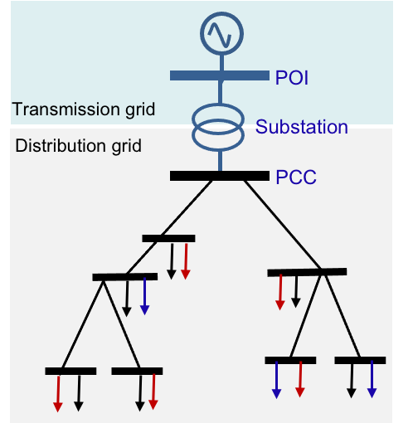
Literature review and our contribution
  4-tpye DSO-DERA-ISO coordination model
 | Type I | Type II | Type III | Type IV
Feature
DSO involvement
Hosting capacity limit
Our method (access limit allocation)
Local energy market
DER aggregation through DSO
No control
Ensure network reliability
Fully coordination
Fully control
POI
Transmission grid
We decouple DSO-DERA-ISO operations:
wholesale market LMP
Substation
Planning problem:
Solar installation capacity limit
Distribution grid
As long as the DERA respects allocated access limits, the DSO only needs to manage network reliability for its own customers.
A DERA can exercise its aggregation policy and participate in the wholesale market without considering distribution network constraints.
PCC
Big “DERA”
DERA1
DSO
DERA2
DSO
DERA4
DERA3
Local energy market with distributed LMP
DSO (net) power
DERA1 (net) power
DERA2 (net) power
Notes:
We divide the literature about DSO-DERA coordination into 4-types. The first with no DSO control in the realtime is just guarantee the solar installation capacity lower than the hosting capacity limit.
Comparatively, type IV is fully controlled by DERA. It’s completely a DERA aggregation through DSO.
Type III here hopes to establish the local energy market over distribution network the same as the wholesale market with distributed LMP. And DSO coordinate in between. Still, lots of coordination for DSO.
Are there any method to further reduce the coordination burden for DSO, and still efficiently use the network? Our method type II hope to fill this blank. We propose the idea to allocate access limits to DERAs and DSO in the distribution network. At main buses over the distribution network, DSO host a forward auction to partition the total access limit at each bus to different DERAs and DSO. And if everyone stay within the network access limit in the real-time operation, we can decompose the DSO-DERA-ISO operation.
As long as the DERA respects allocated access limits, the DSO only needs to manage network reliability for its own customers.
A DERA can exercise its aggregation policy and participate in the wholesale market without considering distribution network constraints.

Slide 4
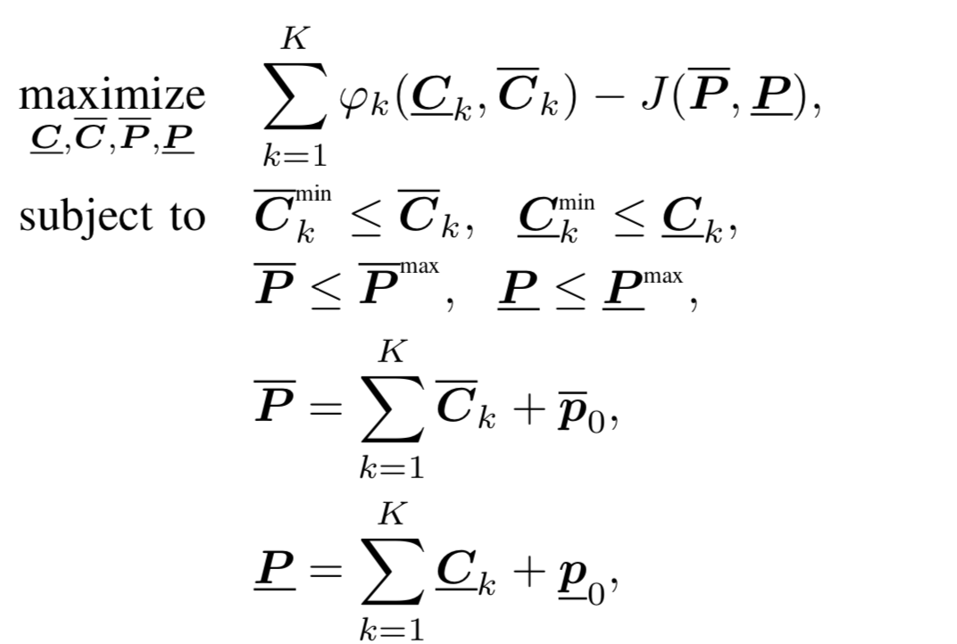


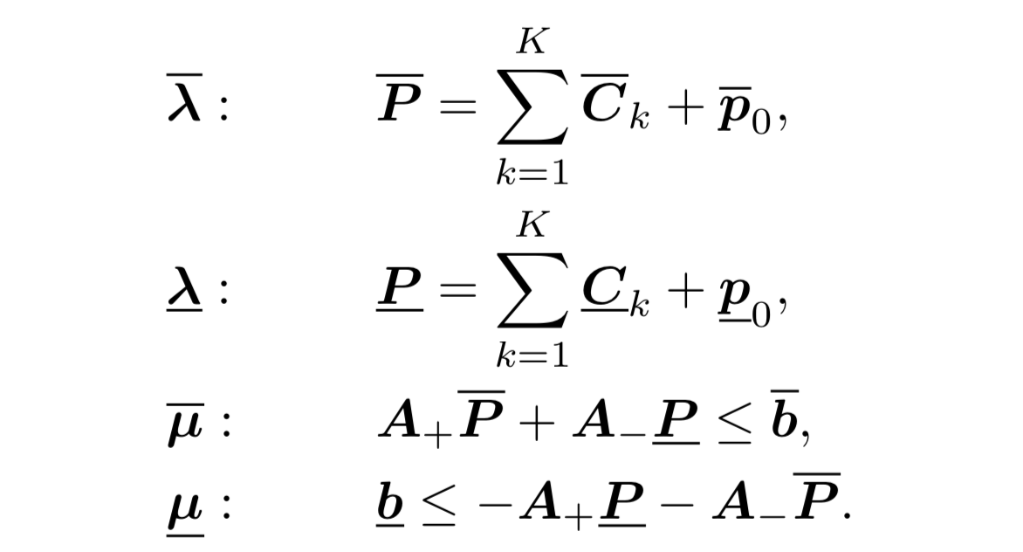
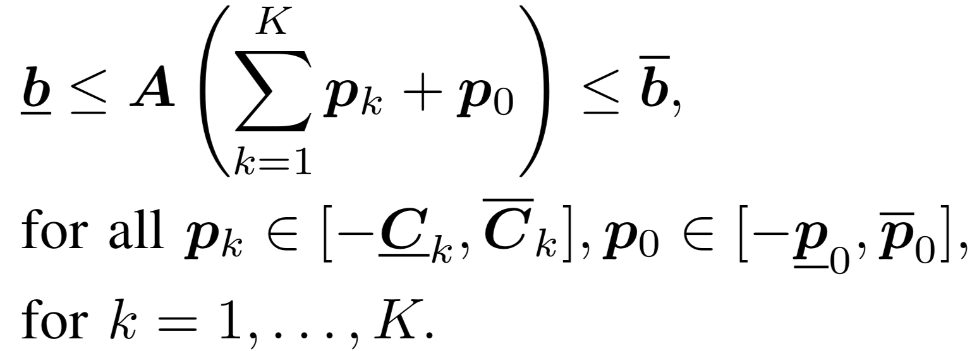
Robust DSO’s network access allocation
  Objectives: Maximize the social welfare while allocating access limits subject to network constraints under all DSO and DERA net-injections
Locational Marginal Access Price (LMAP)
DSO (net) power
DERA1 (net) power
DERA2 (net) power
….
Benefit of DERA
Cost of DSO
Maximize …
POI
Transmission grid
DERA1
Clearing injection access
Substation
Distribution grid
DSO
DERA2
PCC
DERA4
DERA3
Clearing withdrawal access
DERA1
DSO
DERA2
DERA4
DERA3
Notes:
Here is the model. In the objective function, we received the bidding benefit from DERA, representing how much DERA is willing to pay for a certain amount of injection and withdrawal access. And we minus the operation cost of DSO to support the total amount of the network access. It’s like social welfare maximization in the wholesale market.
And we clear for both the injection and withdrawal access with these two equations. The total network injection and withdrawal limit equals to the sum of access limit assigned to DSO and DERAs. To realize the decomposition of DSO-DERA coordination, DSO needs to ensure that for any net injection of DSO and DERA, if they stay within the access limit, the power flow and voltage limit should not be violated. Such a “for all” require robust optimization to realize. Luckily, with the linearized power flow model, we have the equivalence of this robust optimization and the optimization can be solved efficiently.
As for the pricing for the network access, we use marginal pricing like LMP, taking the dual variable associate with the equality market clearing conditions and defined as the locational marginal access price
Pause: The DERA don’t need to know the network parameters/topology when coming up its aggregation and bidding strategies. It only needs to stay within the access limit.

Slide 5
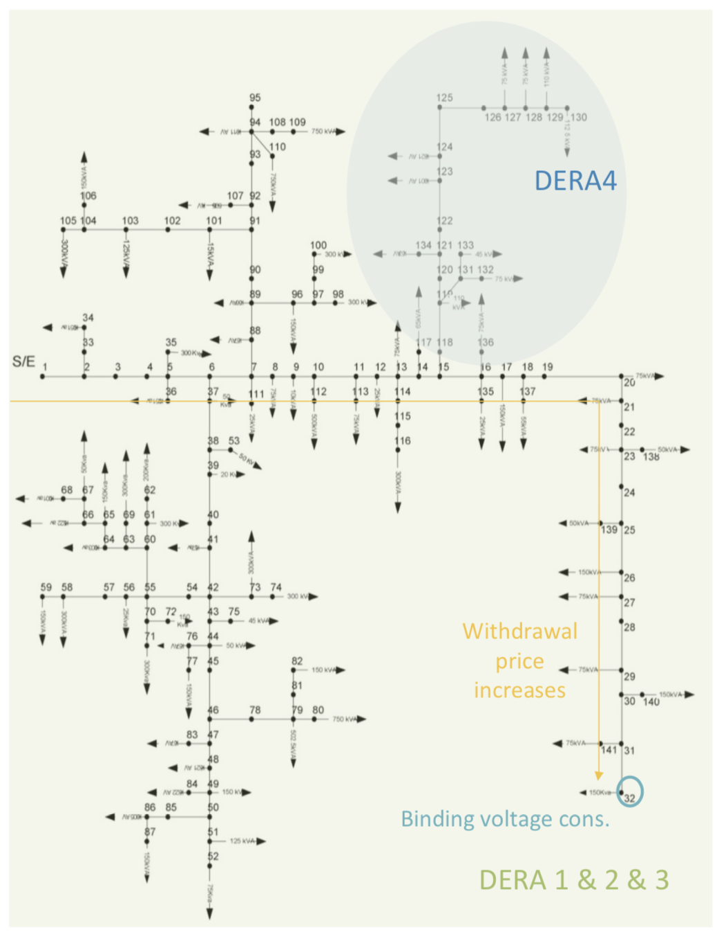
Properties and the simulation result
Proposition 1: DERA nonnegative surplus
Proposition 3: Price monotonicity
Proposition 2: DSO revenue adequacy
Stoch
Stoch
20% gain in surplus by tolerating less than 1% constraint violation risk
Stoch
Stoch
Robust
Robust
Average injection of DSO’s customer
Average injection of DSO’s customer
Notes:
For the time limit here, I’ll explain more details about the properties we proved and the simulation in the poster session.
We prove Proposition 1 that the surplus of DERA is nonnegative under certain conditions. And in the simulation we can see over all robust or stochastic case, the DERA surplus is above zero. Mover, comparing the robust and stochastic access allocation mechanism, For DSO surplus. In Proposition 2 we prove the revenue adequacy of DSO.
Lastly, we proved an interesting Proposition 3 for the price monotonicity over one feeder.

Slide 6
Key take-aways:
Network access allocation mechanism to Multi-DERA
Decouple the operation of DSO-DERA-ISO
Robust and stochastic allocation mechanism
Competitive DER aggregation model
Working paper:
C. Chen, S. Bose, T. D. Mount, and L. Tong, “Wholesale market participation of DERA part I: DSO-DERA-ISO coordination,” [Online], available 2023/07/06) at arXiv: 2307.01999. [Online].
Available: http:// arxiv.org/abs/2307.01999
C. Chen, A. S. Alahmed, T. D. Mount, and L. Tong, “Wholesale market participation of DERA part II: Competitive DER aggregation,” [Online], available 2023/07/06) at arXiv: 2307.02004. [Online].
Available: http:// arxiv.org/abs/2307.02004
Notes:
To conclude, the main contribution is that we propose a network allocation mechanism to multi-DERA, which decouple DSO-DERA-ISO operations in the real-time electricity market, ensuring the distribution system reliability independent of DERAs' aggregation actions and wholesale market conditions. To cope with DER uncertainty, we propose the robust and stochastic network access allocation mechanism.
In our paper posted on arXiv, we also develop competitive profit-maximizing aggregation strategies for DERAs and their bidding strategies as virtual storage participants in the wholesale market.

